Slide 1
Tutorial Machine Learning in Solid Mechanics
Task 4: Viscoelasticity
Fabian Roth

Slide 2
Tutorial Machine Learning in Solid Mechanics
Sections
4.1
Simple RNN
4.2
Maxwell model
4.3
FFNN Maxwell model
4.4
GSM model

Slide 3
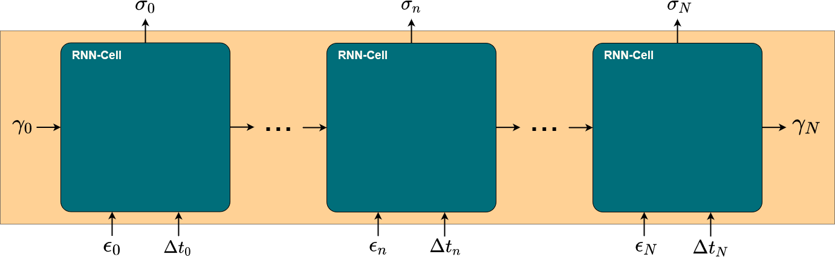
Tutorial Machine Learning in Solid Mechanics
RNN Architecture

Slide 4
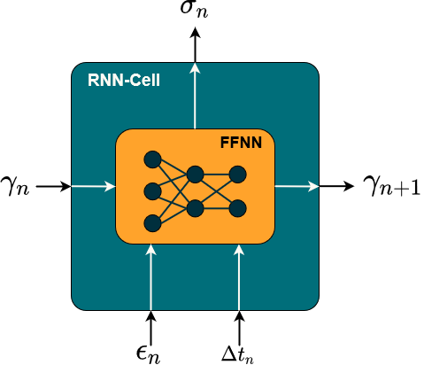

4 - 2.1
Simple RNN
Physical Knowledge:
Thermodynamics
Equilibrium stiffness
Non equilibrium stiffness
Relaxation behavior

Slide 5
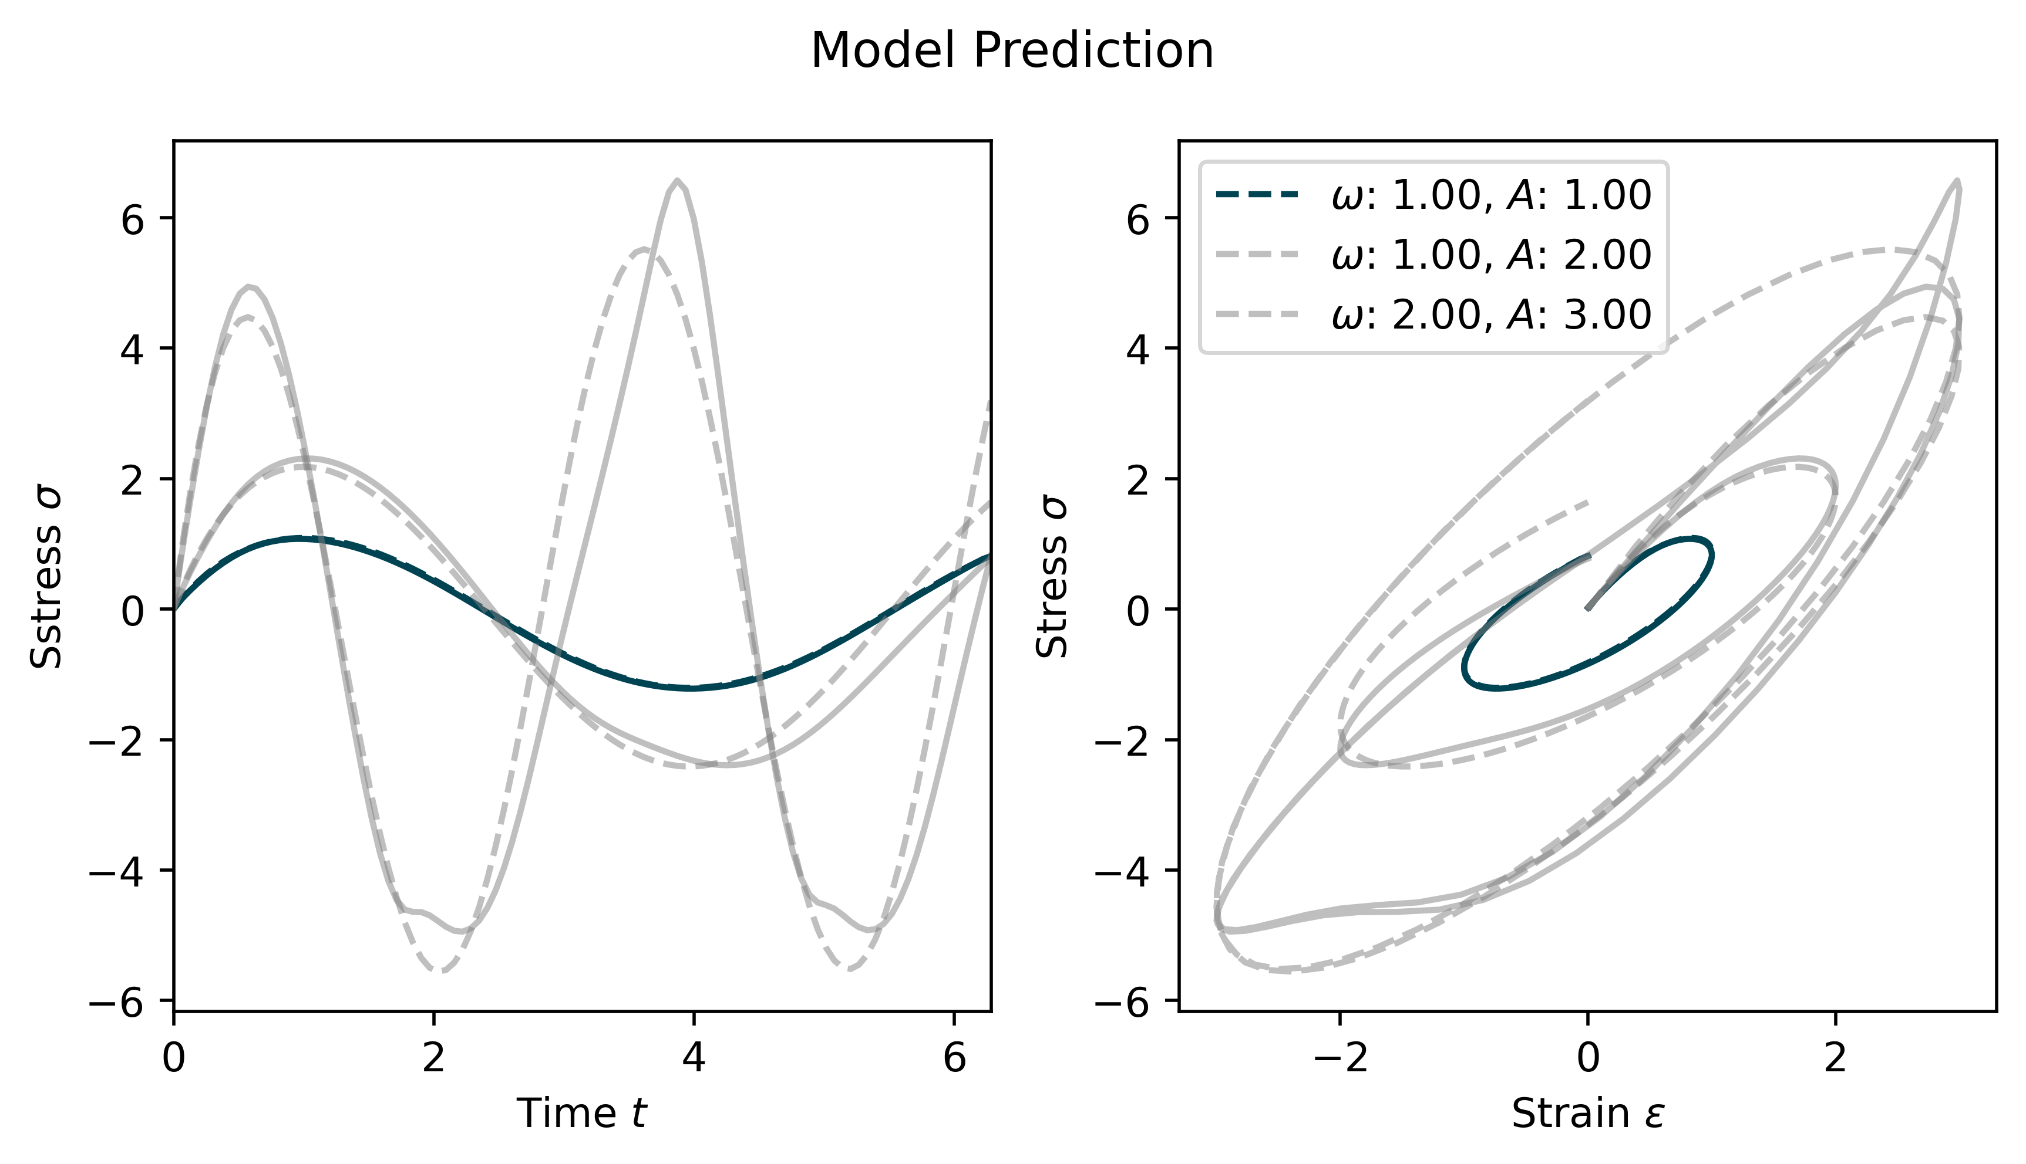
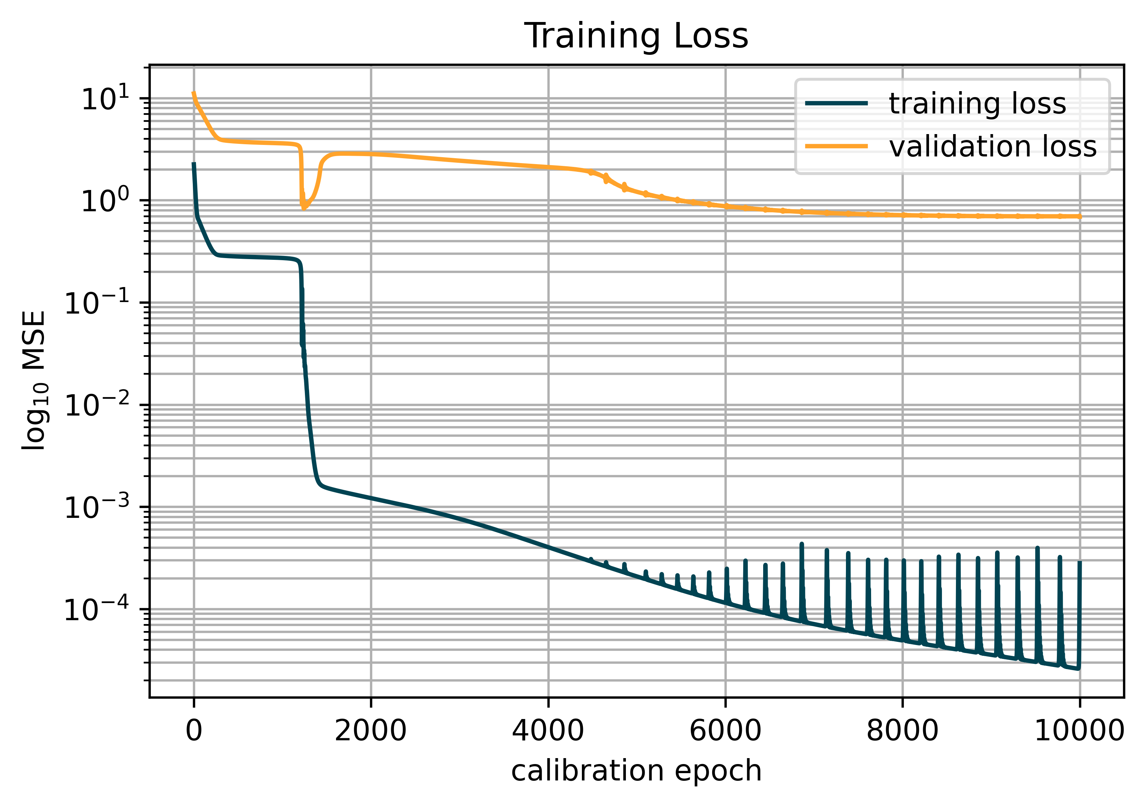
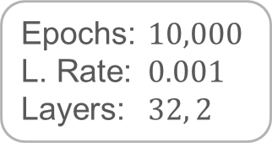
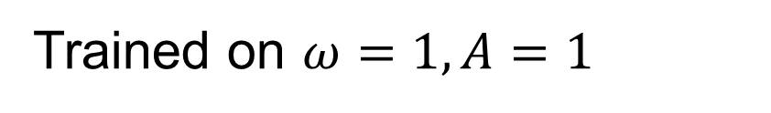
4 - 2.1
Simple RNN
Epochs: $10,000$
L. Rate: $0.001$
Layers: $32, 2$
Trained on $ω=1, A=1$
Notes:
Slow convergance after 4000 epochs; Overfitting

Slide 6
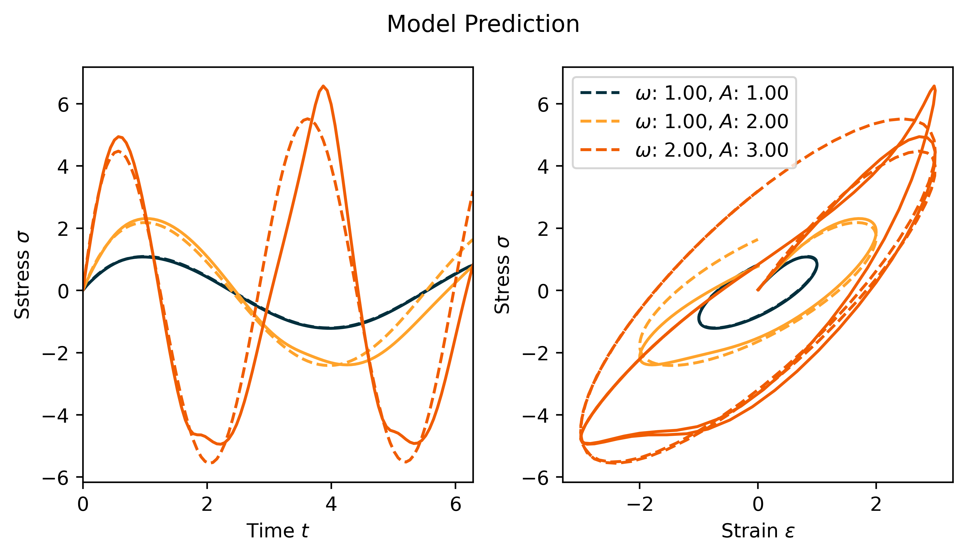
4 - 2.1
Simple RNN
Epochs: $10,000$
L. Rate: $0.001$
Layers: $32, 2$
Trained on $ω=1, A=1$
Notes:
Slow convergance after 4000 epochs; Overfitting

Slide 7
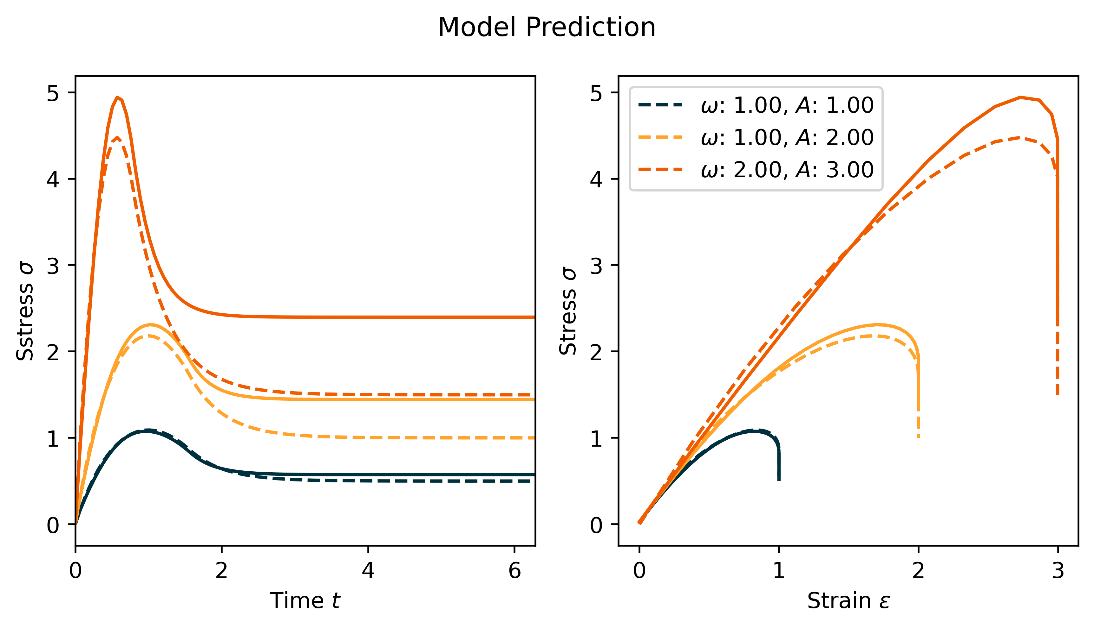
4 - 2.1
Simple RNN
Epochs: $10,000$
L. Rate: $0.001$
Layers: $32, 2$
Trained on $ω=1, A=1$
Notes:
Slow convergance after 4000 epochs; Overfitting

Slide 8
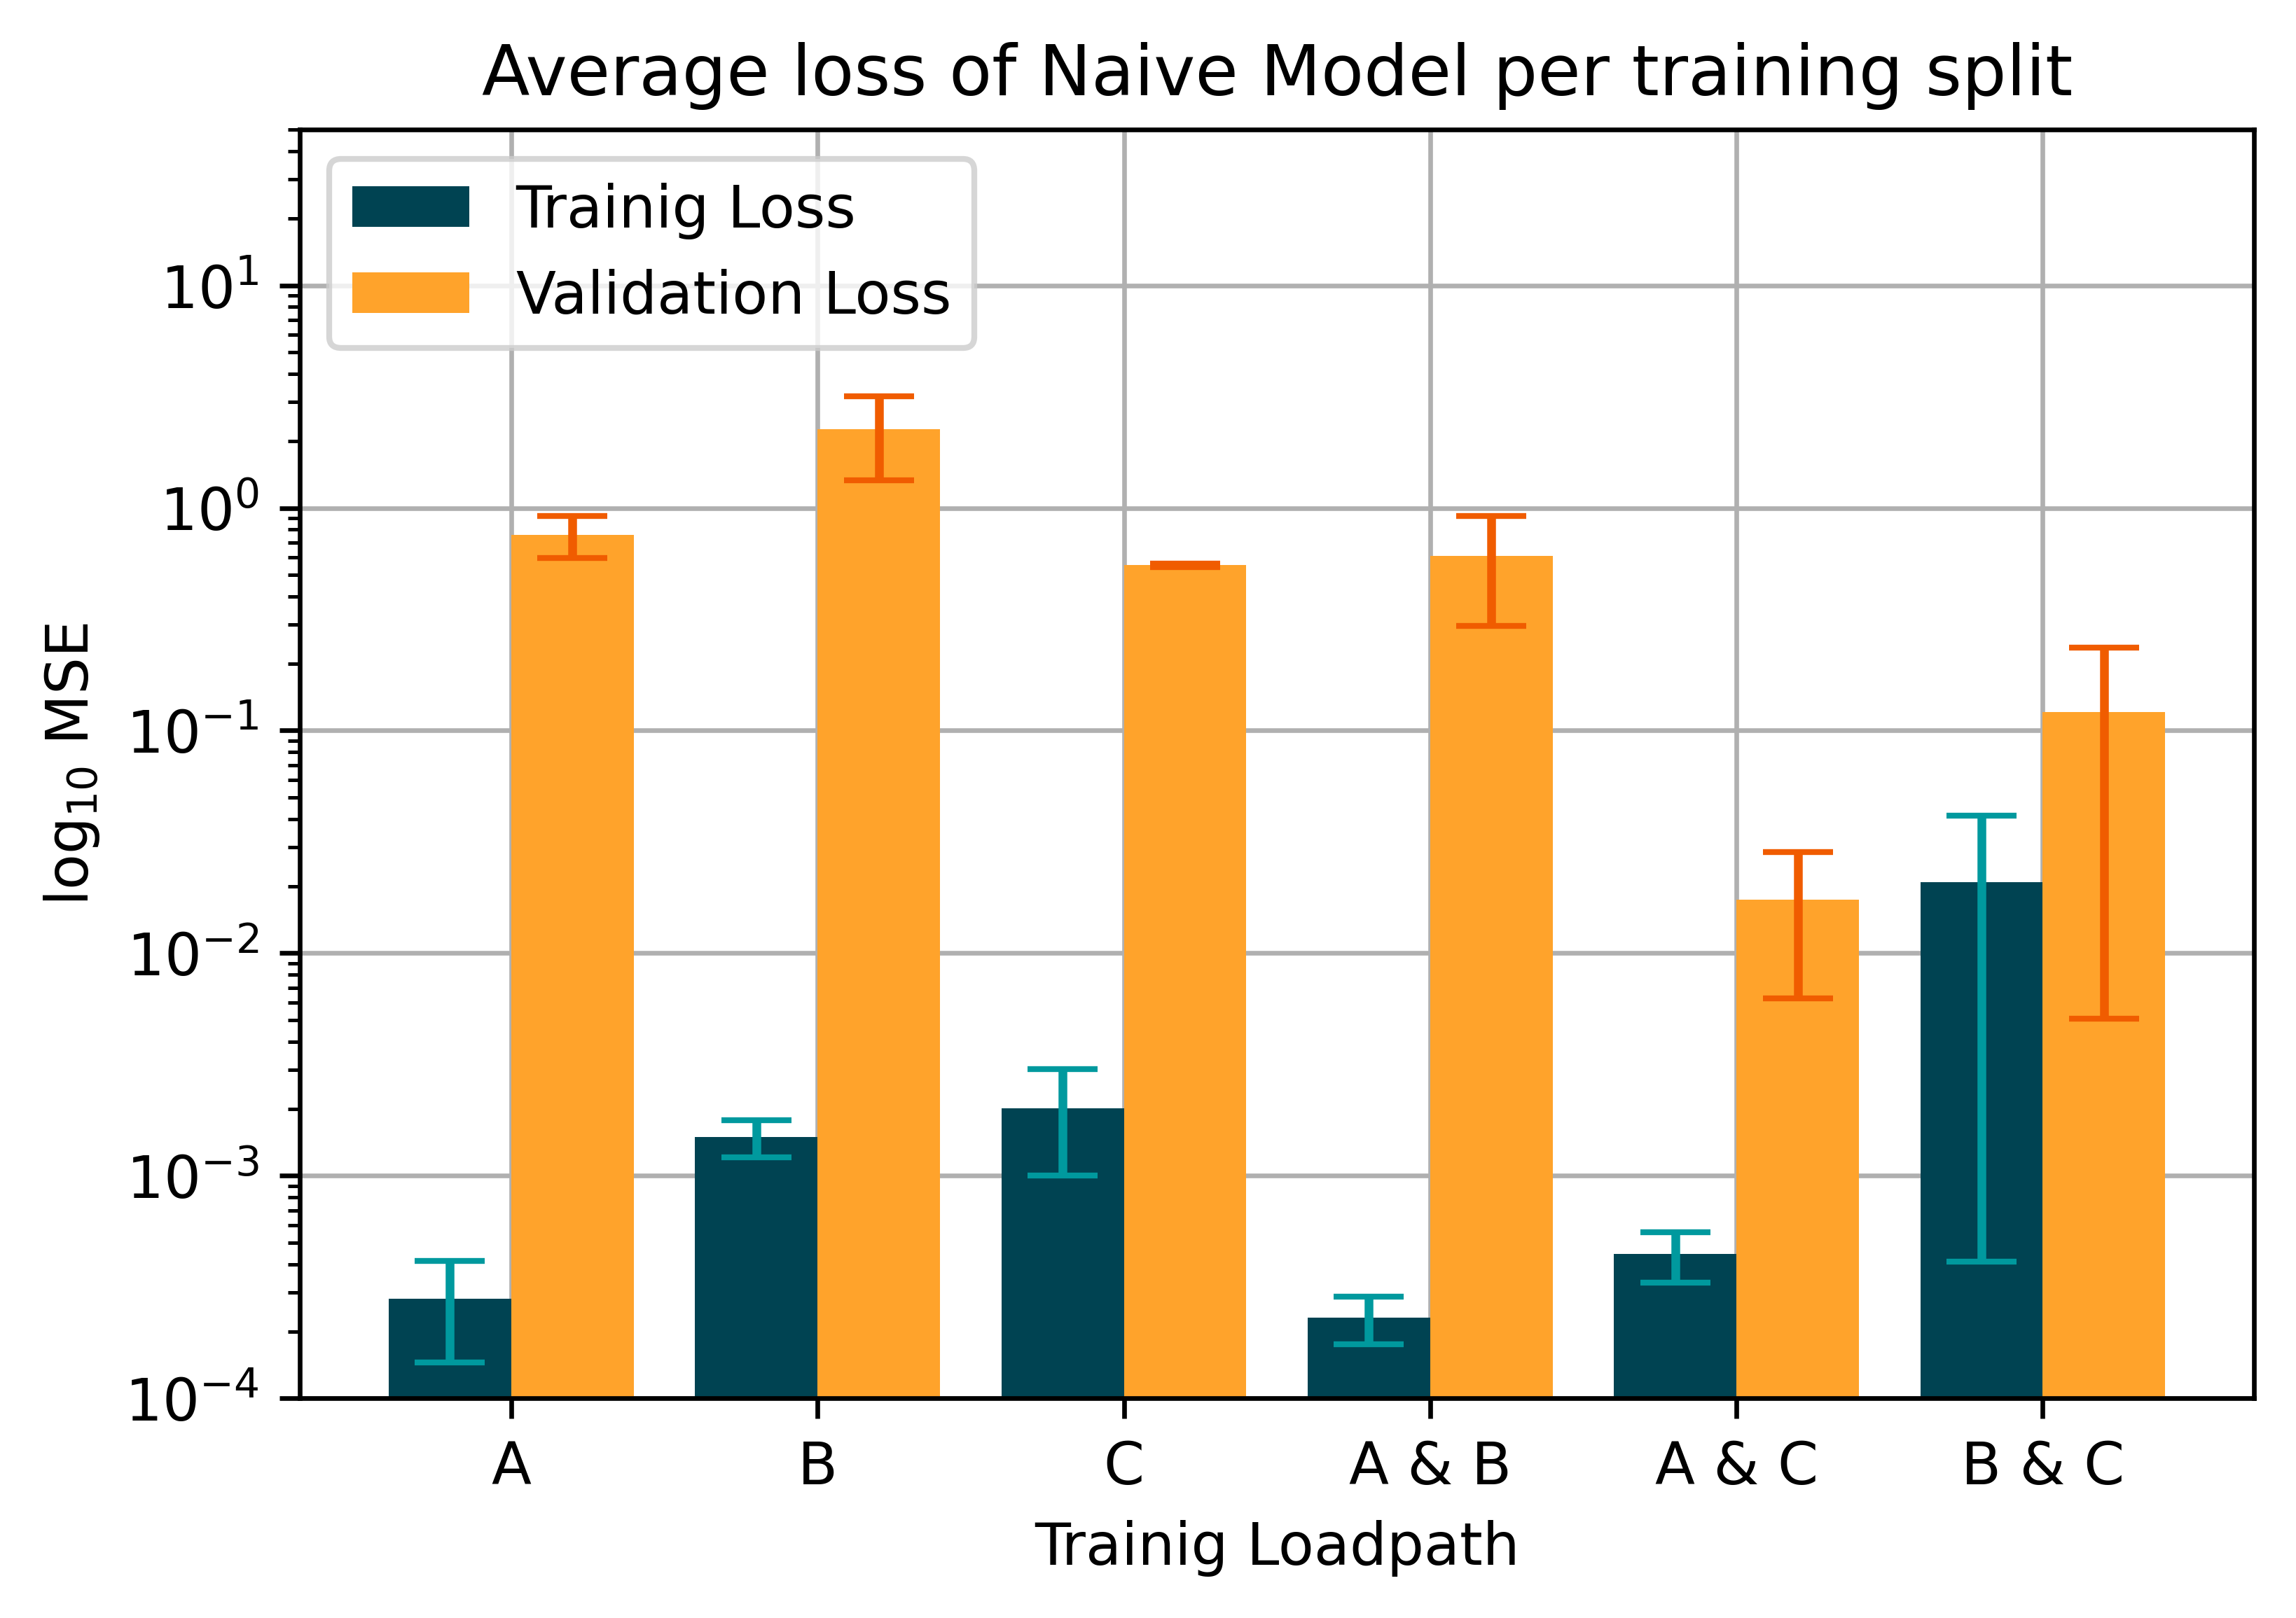
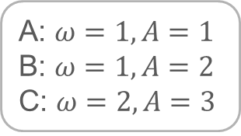
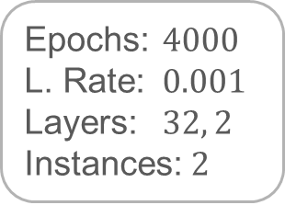
4 - 2.1
Simple RNN
A: $ω=1, A=1$
B: $ω=1, A=2$
C: $ω=2, A=3$
Epochs: $4000$
L. Rate: $0.001$
Layers: $32, 2$
Instances: $2$

Slide 9
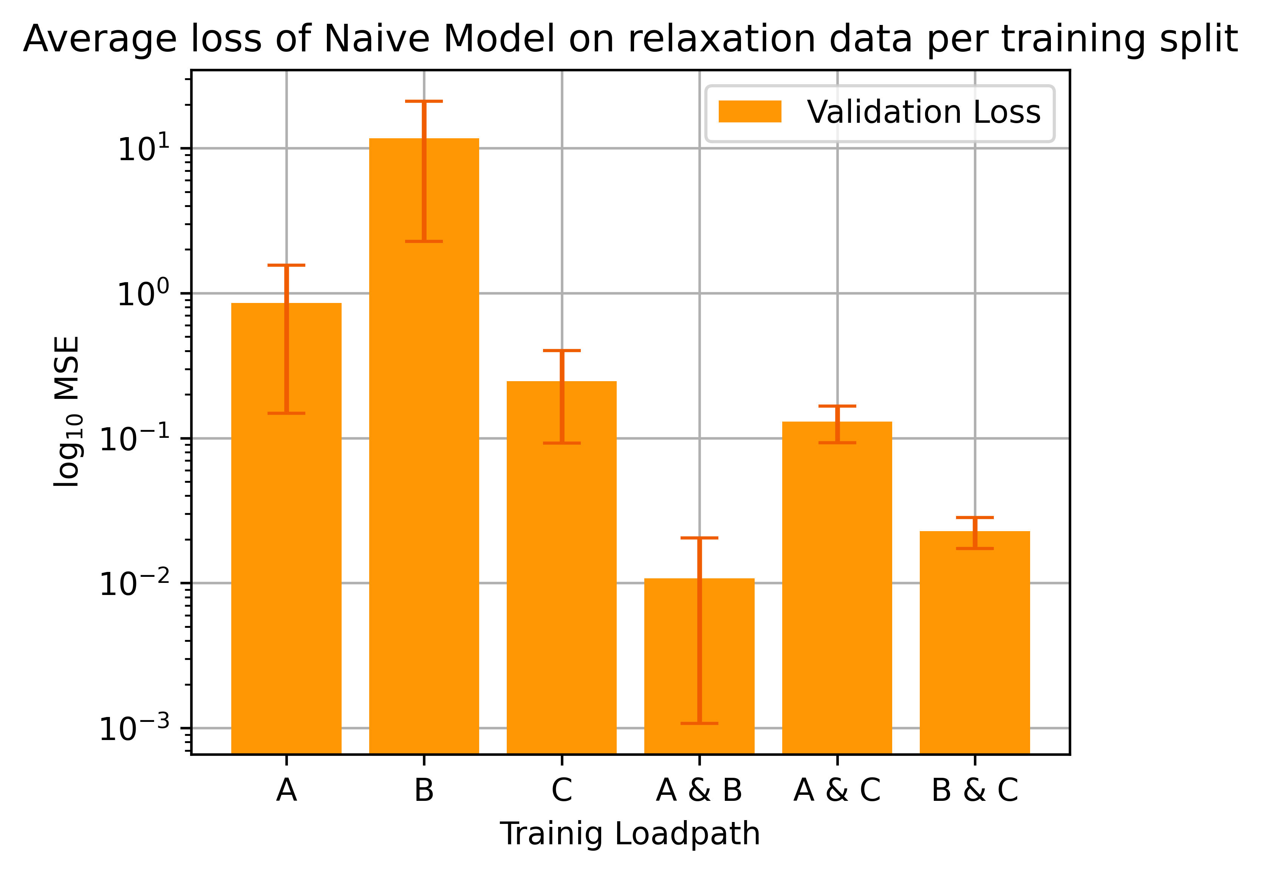
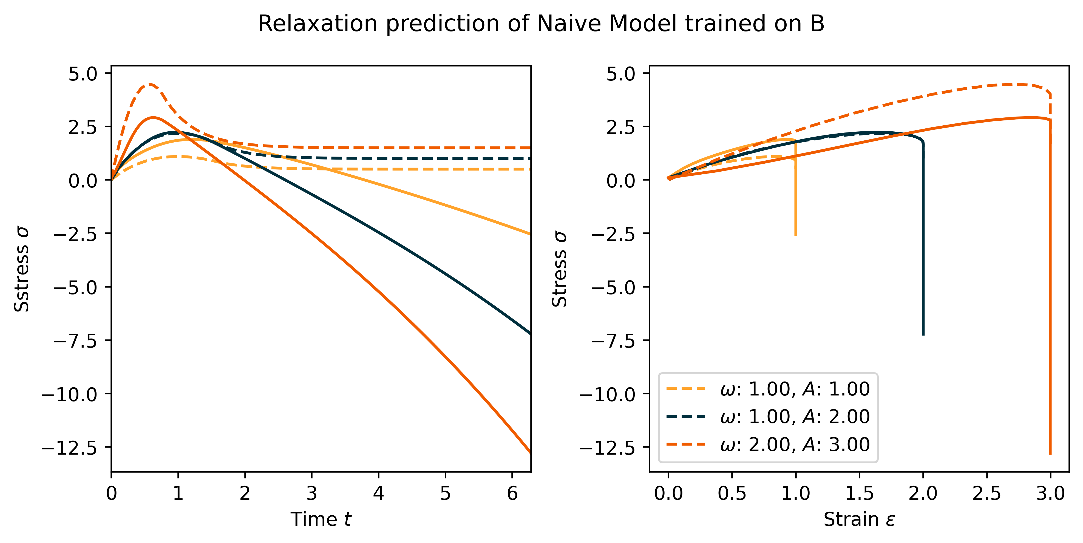
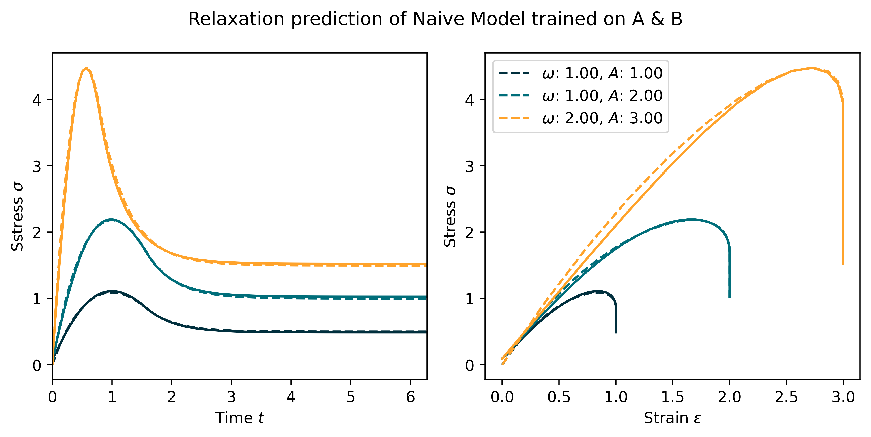
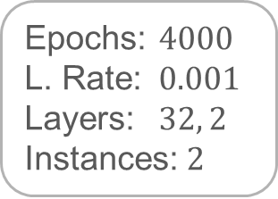
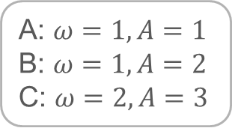
4 - 2.1
Simple RNN
Epochs: $4000$
L. Rate: $0.001$
Layers: $32, 2$
Instances: $2$
A: $ω=1, A=1$
B: $ω=1, A=2$
C: $ω=2, A=3$

Slide 10
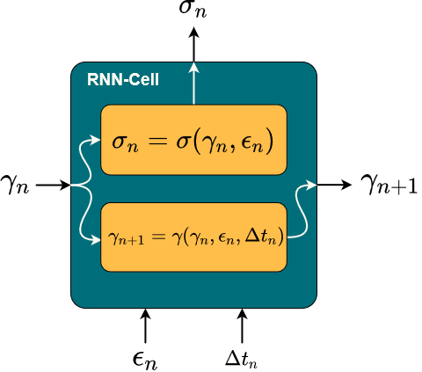
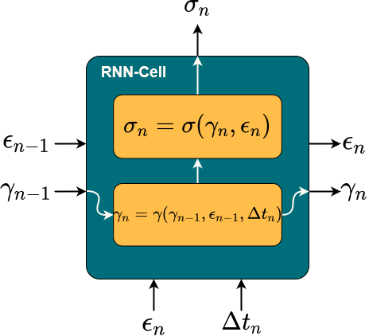
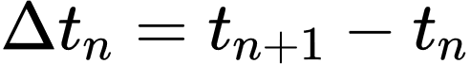
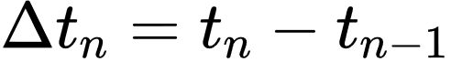
4 - 2.2
Analytic Maxwell model

Slide 11
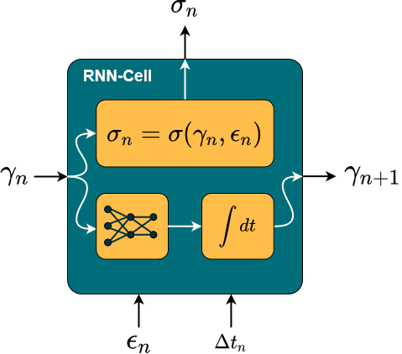

4 - 2.3
FFNN Maxwell model
Physical Knowledge:
Thermodynamics*
Equilibrium stiffness
Non equilibrium stiffness
Relaxation behavior
*For exact integration

Slide 12
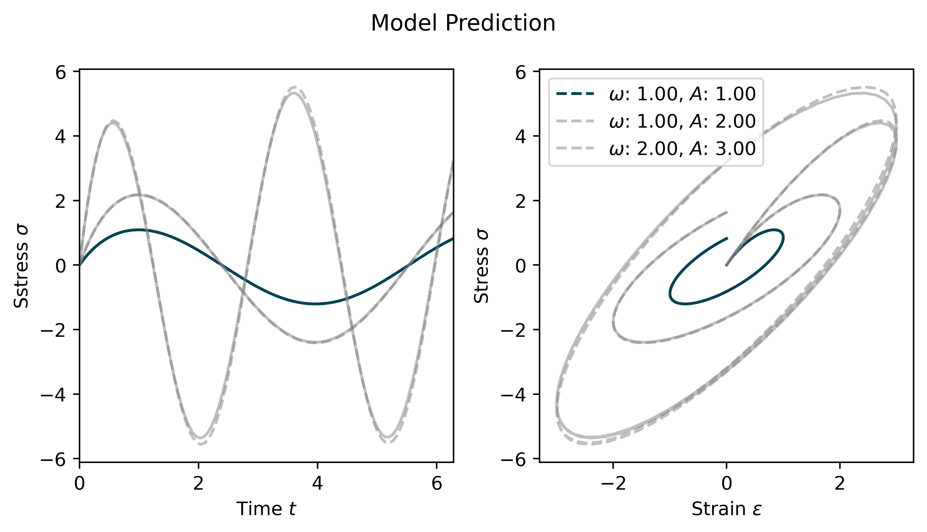
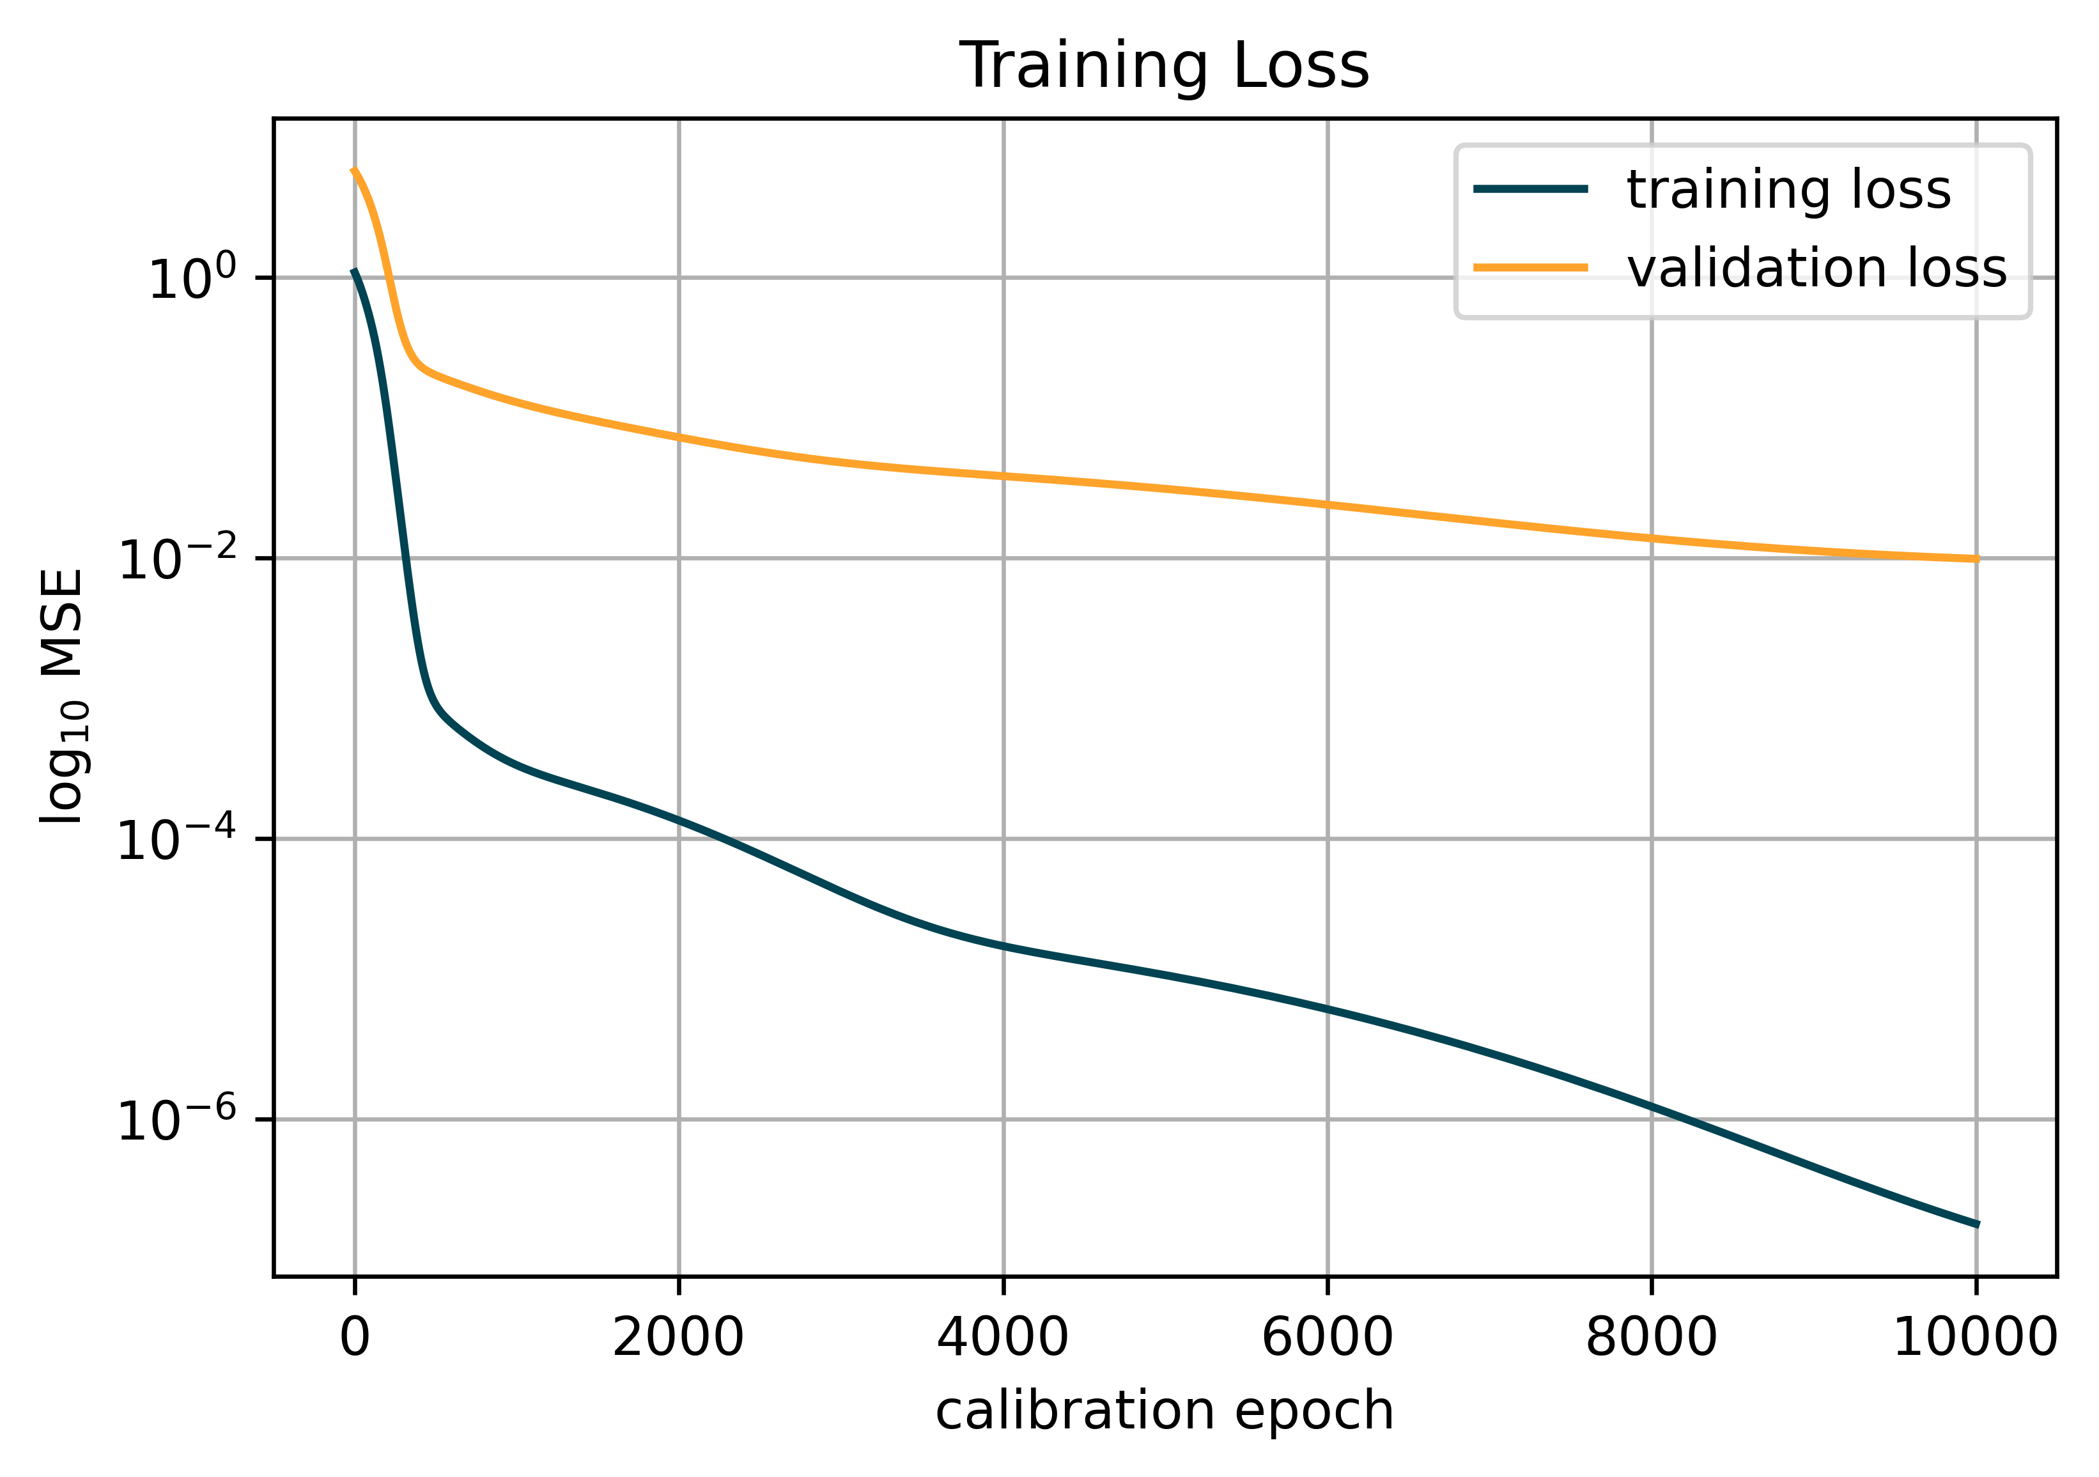
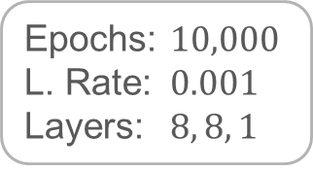
4 - 2.3
FFNN Maxwell model
Epochs: $10,000$
L. Rate: $0.001$
Layers: $8, 8, 1$
Trained on $ω=1, A=1$

Slide 13
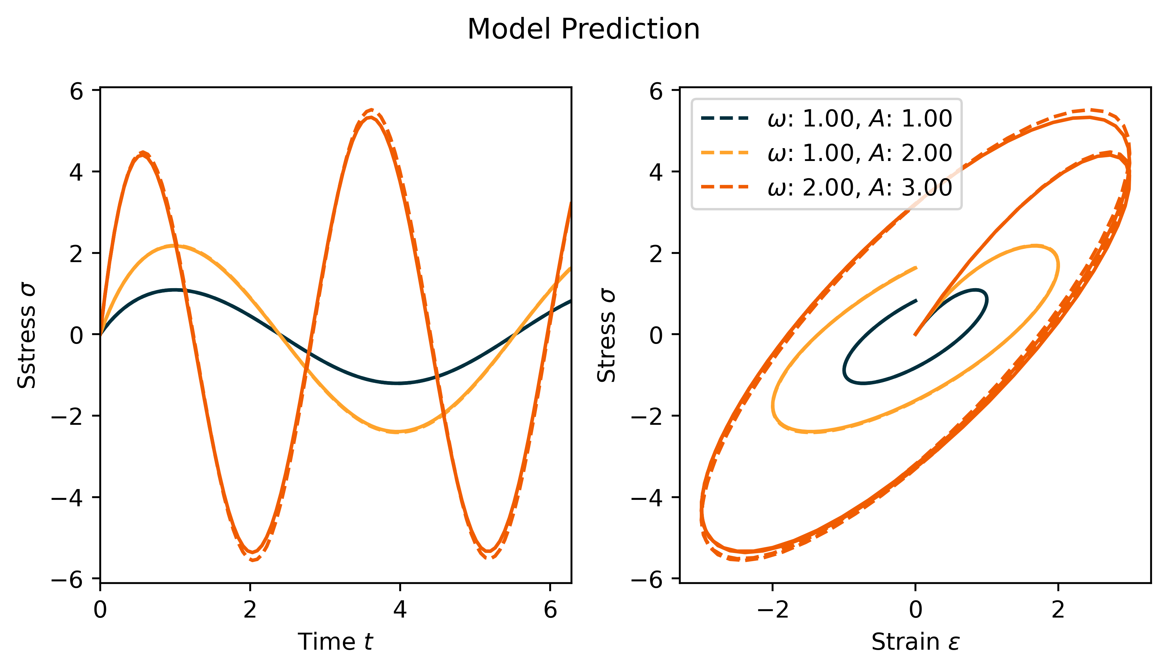
4 - 2.3
FFNN Maxwell model
Epochs: $10,000$
L. Rate: $0.001$
Layers: $8, 8, 1$
Trained on $ω=1, A=1$

Slide 14
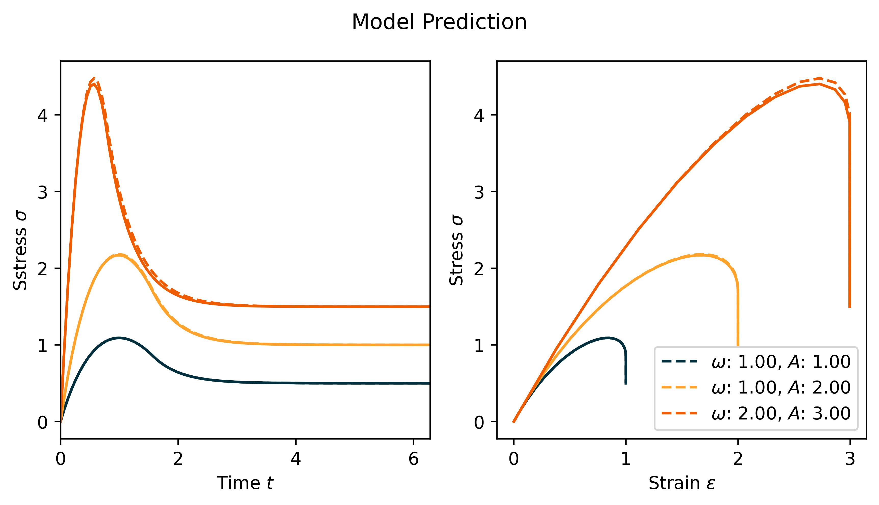
4 - 2.3
FFNN Maxwell model
Epochs: $10,000$
L. Rate: $0.001$
Layers: $8, 8, 1$
Trained on $ω=1, A=1$

Slide 15
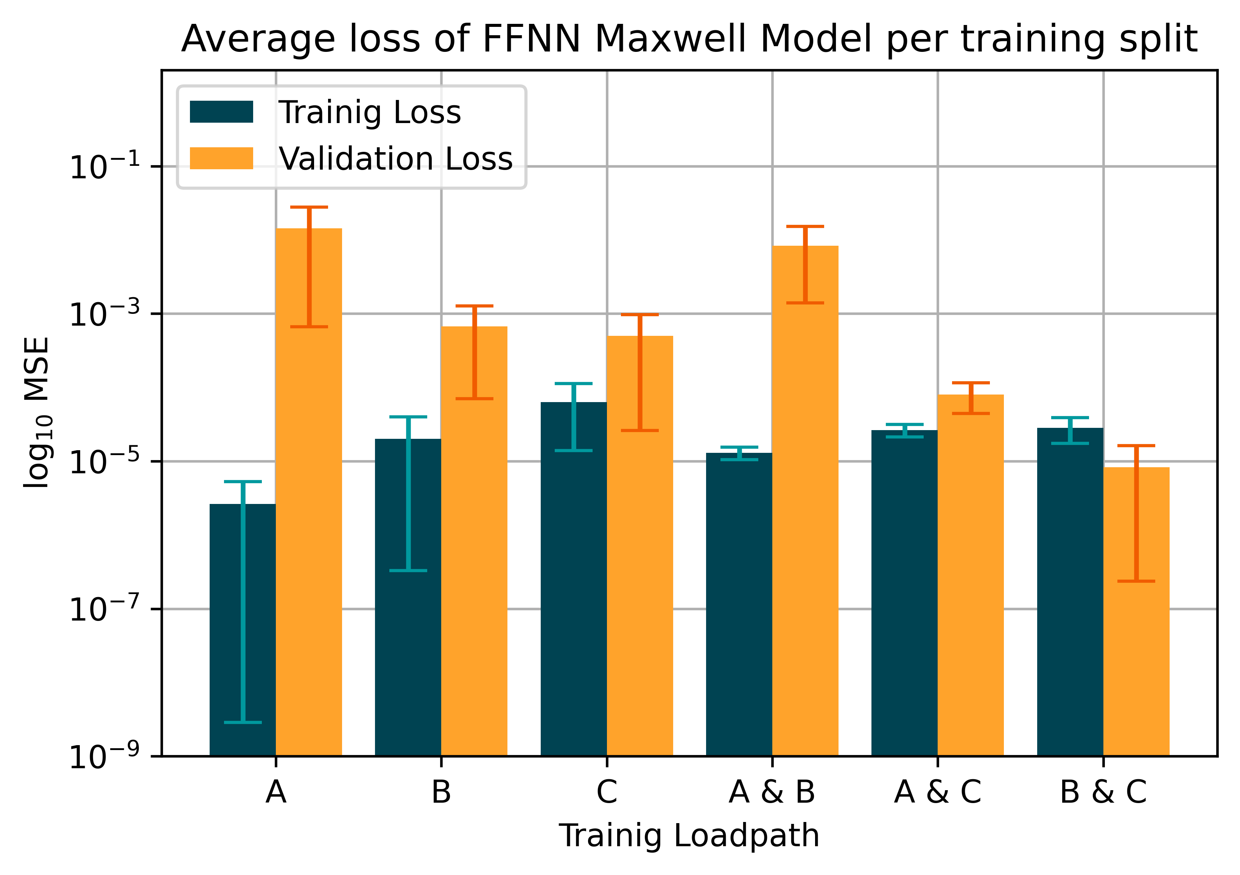
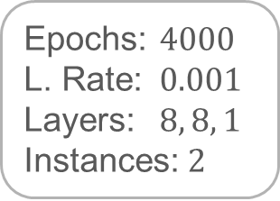
4 - 2.3
FFNN Maxwell model
A: $ω=1, A=1$
B: $ω=1, A=2$
C: $ω=2, A=3$
Epochs: $4000$
L. Rate: $0.001$
Layers: $8, 8, 1$
Instances: $2$

Slide 16
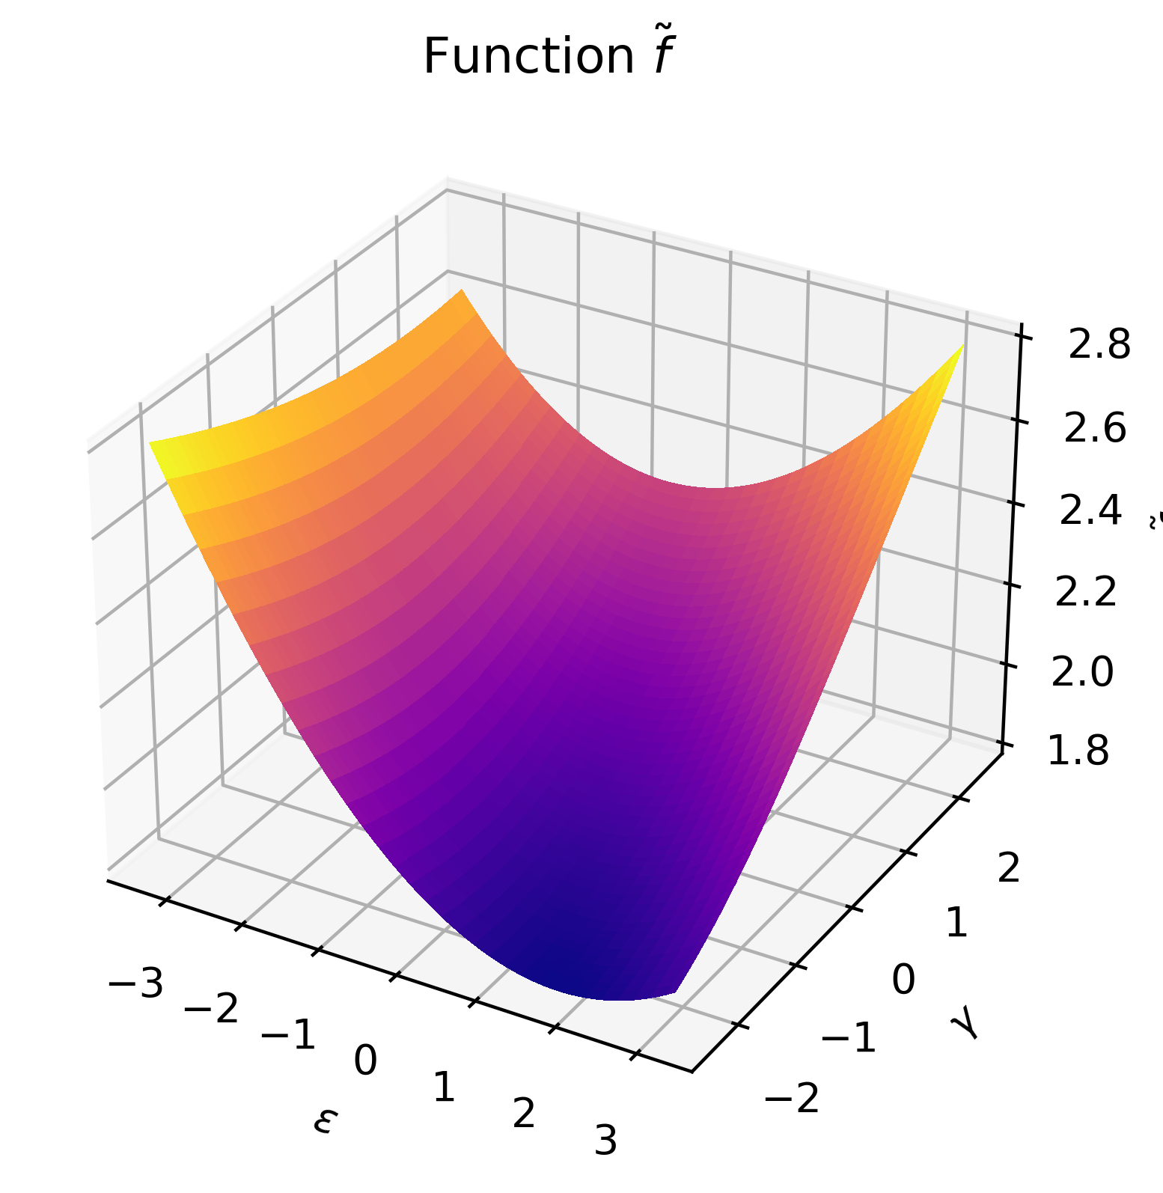
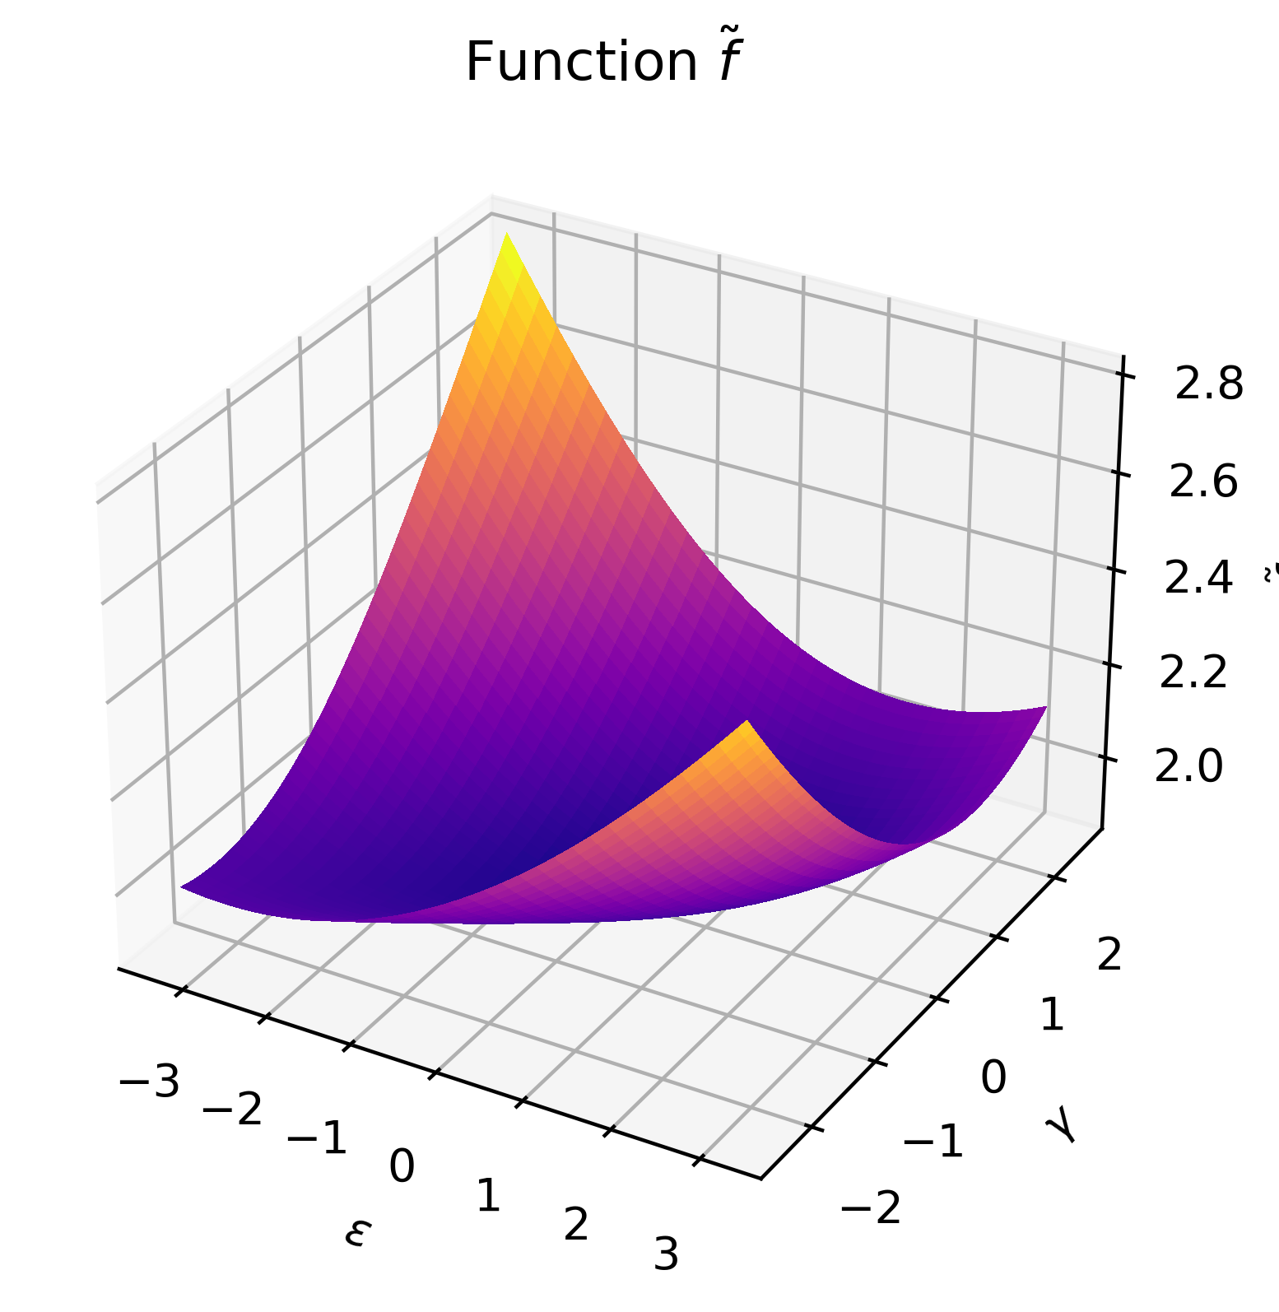
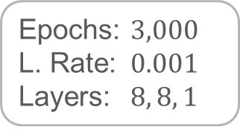
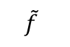
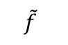
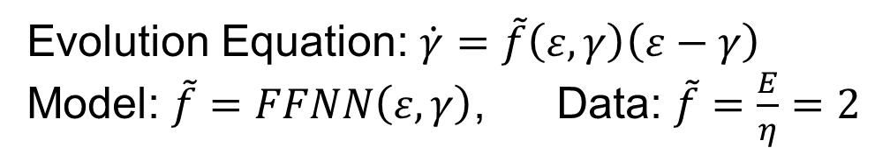
4 - 2.3
FFNN Maxwell model
Epochs: $3,000$
L. Rate: $0.001$
Layers: $8, 8, 1$
Evolution Equation: $\dot{γ}=\tilde{f}\left(ε,γ\right)\left(ε−γ\right)$
Model: $\tilde{f}=FFNN\left(ε,γ\right)$, Data: $\tilde{f}=\frac{E}{η}=2$
Trained on A
Trained on C
$$\tilde{f}$$
$$\tilde{f}$$

Slide 17
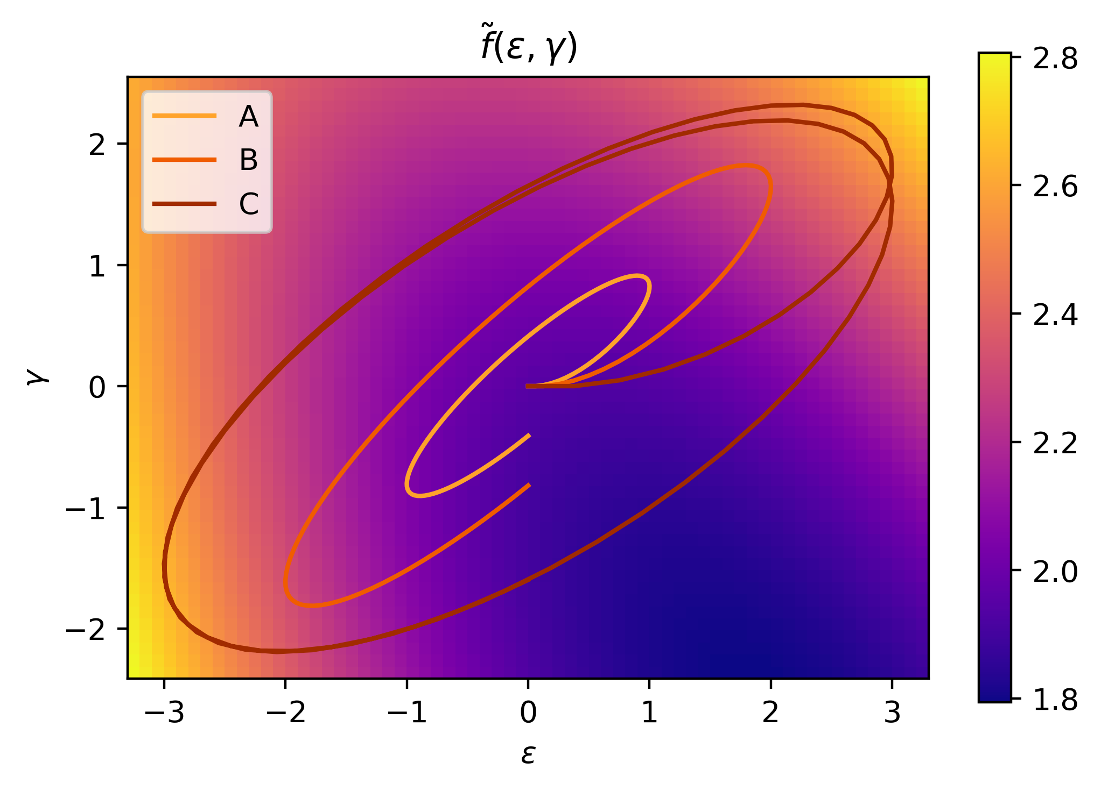
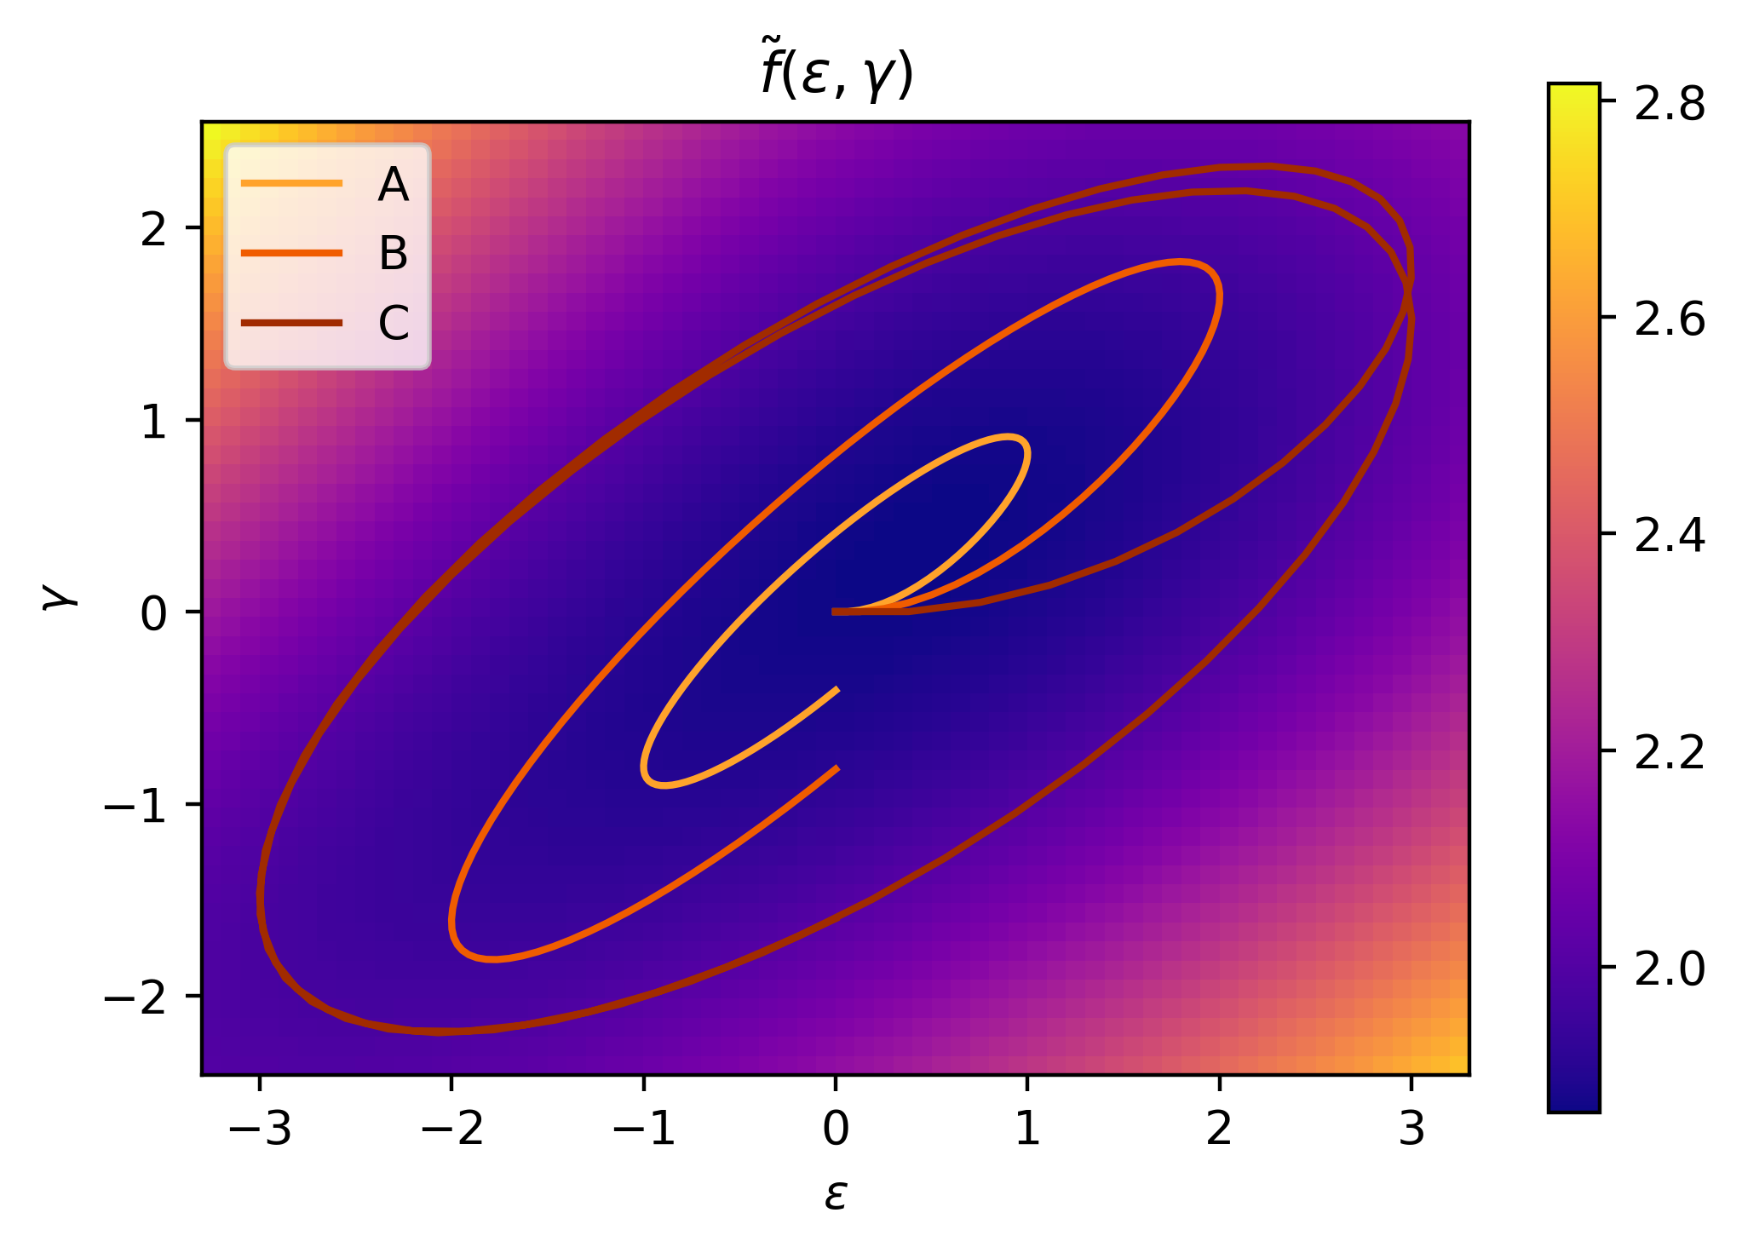
4 - 2.3
FFNN Maxwell model
Epochs: $3,000$
L. Rate: $0.001$
Layers: $8, 8, 1$
Trained on A
Trained on C

Slide 18
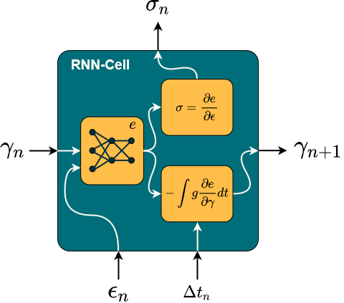
4 - 2.4
GSM model
Physical Knowledge:
Thermodynamics*
Equilibrium stiffness
Non equilibrium stiffness
Relaxation behavior
*For exact integration

Slide 19
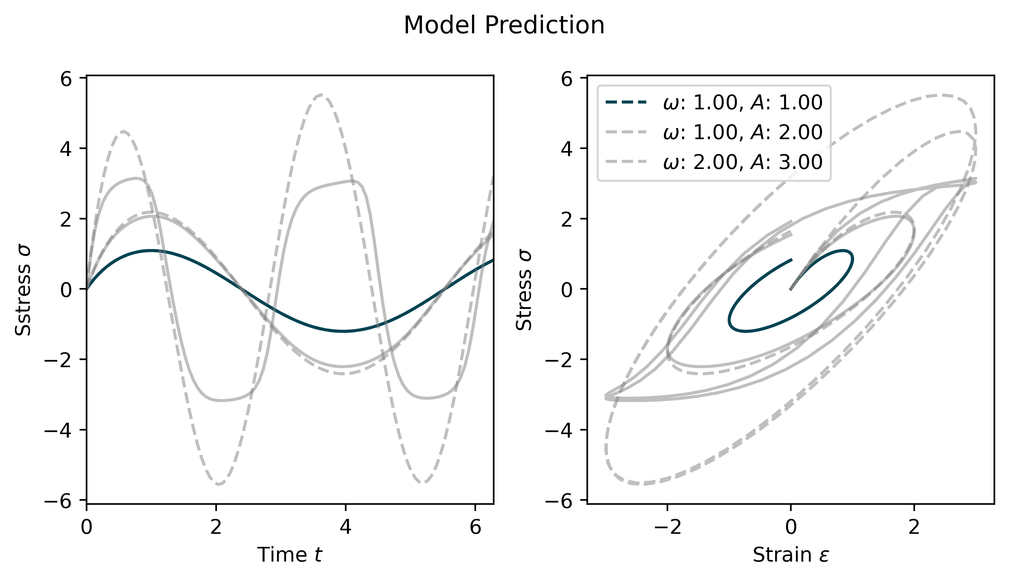
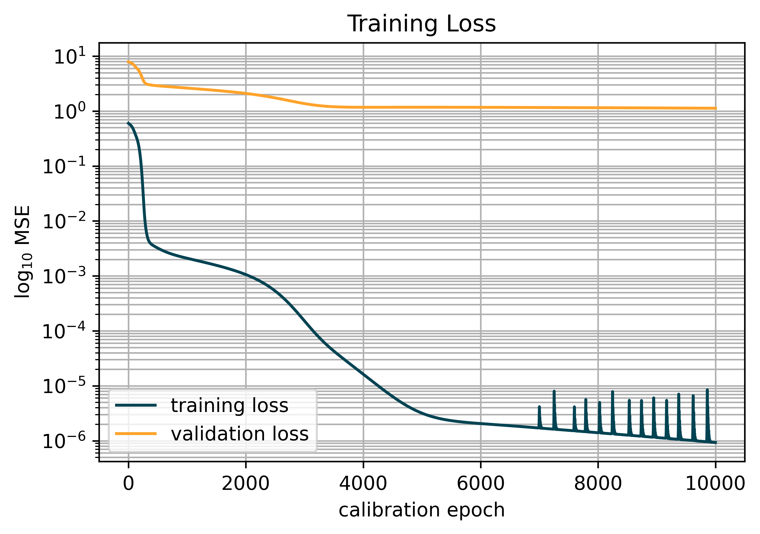
4 - 2.4
GSM model
Epochs: $10,000$
L. Rate: $0.001$
Layers: $8, 8, 1$
Trained on $ω=1, A=1$

Slide 20
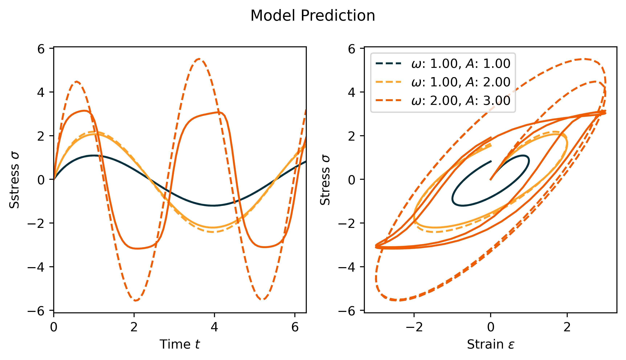
4 - 2.4
GSM model
Epochs: $10,000$
L. Rate: $0.001$
Layers: $8, 8, 1$
Trained on $ω=1, A=1$

Slide 21
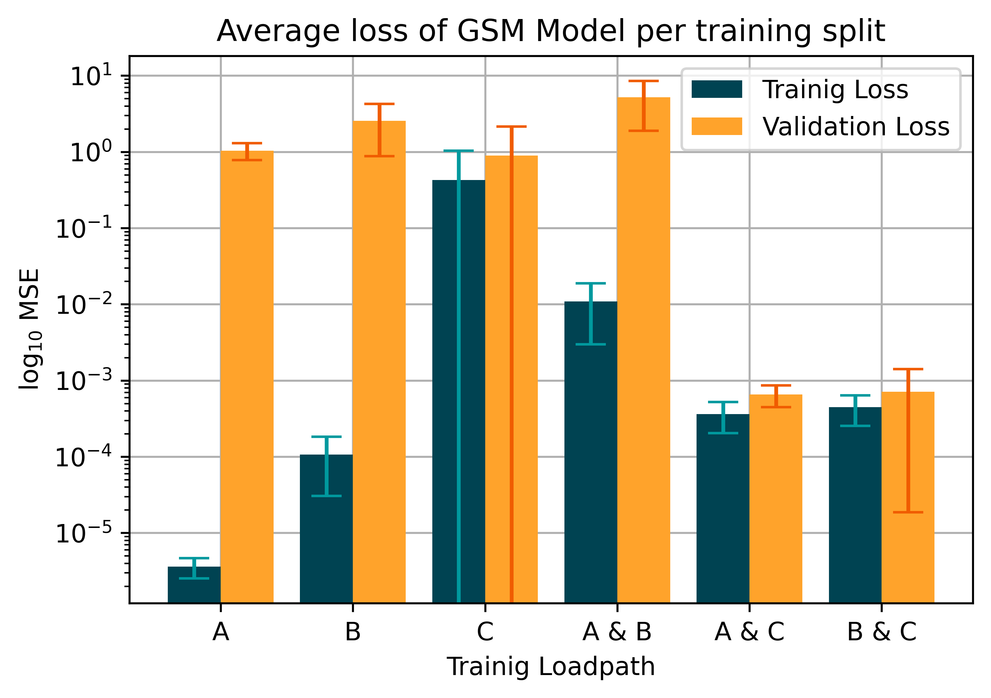
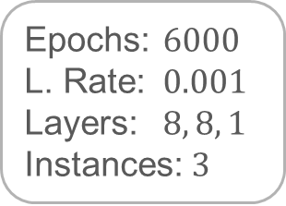
4 - 2.4
GSM model
A: $ω=1, A=1$
B: $ω=1, A=2$
C: $ω=2, A=3$
Epochs: $6000$
L. Rate: $0.001$
Layers: $8, 8, 1$
Instances: $3$

Slide 22
Tutorial Machine Learning in Solid Mechanics
Discussion

Slide 23
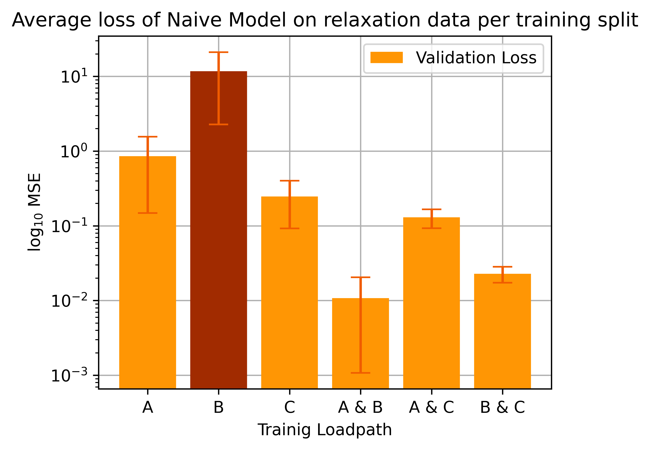
4 - 2.1
Simple RNN
Epochs: $4000$
L. Rate: $0.001$
Layers: $32, 2$
Instances: $2$
A: $ω=1, A=1$
B: $ω=1, A=2$
C: $ω=2, A=3$

Slide 24
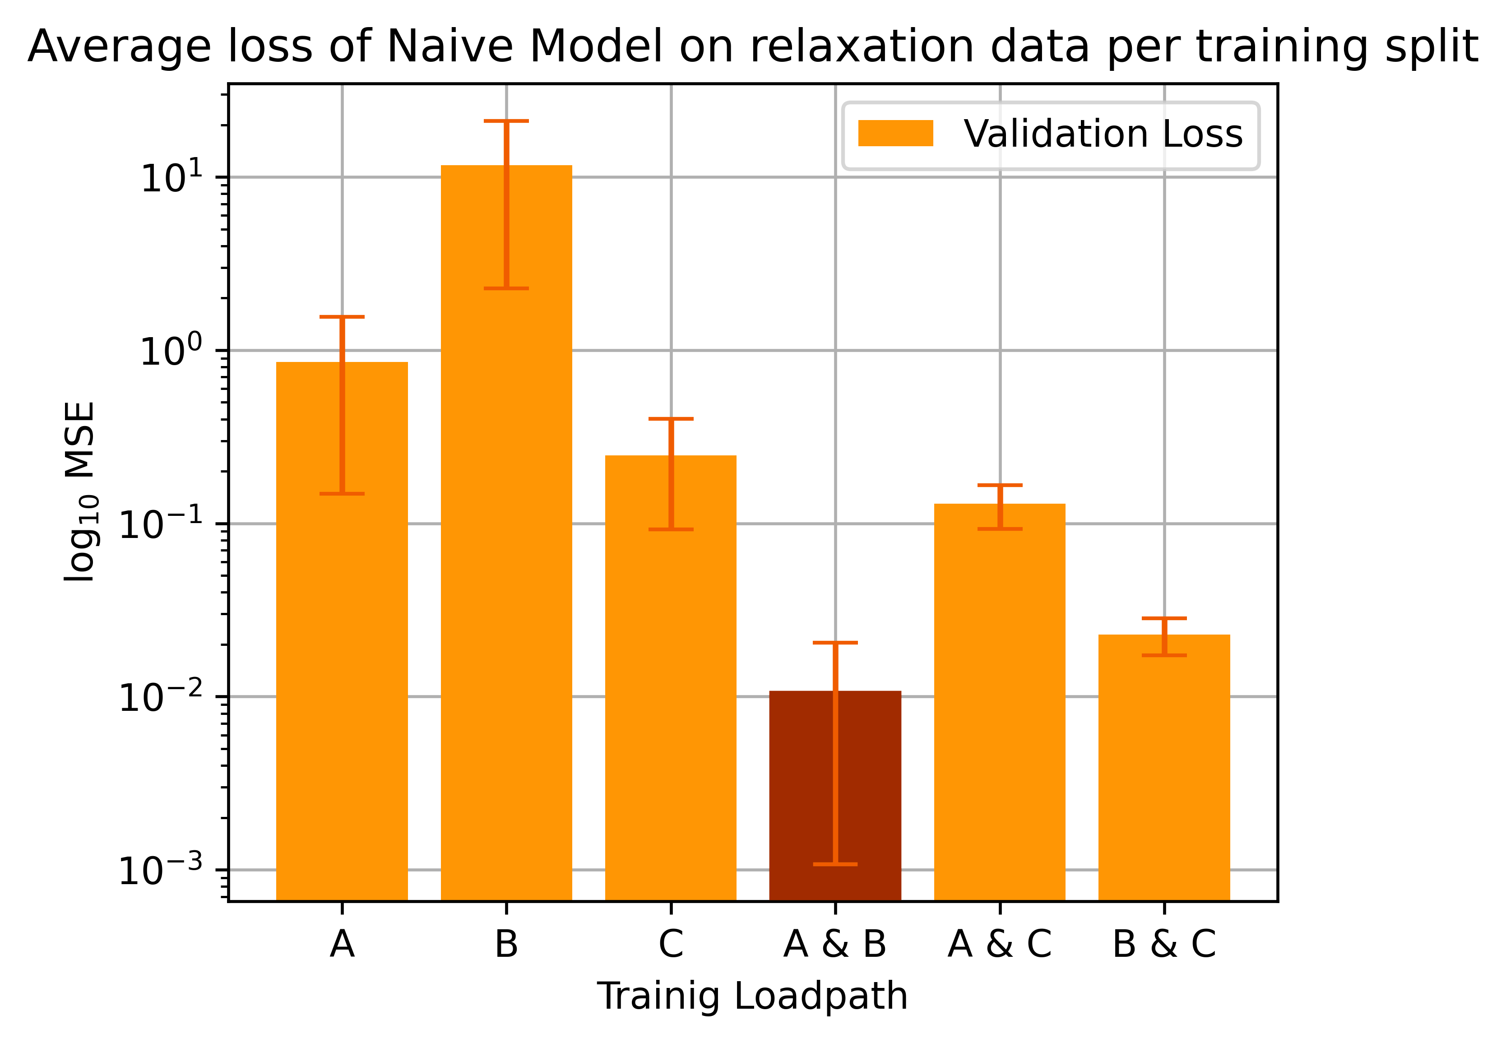
4 - 2.1
Simple RNN
Epochs: $4000$
L. Rate: $0.001$
Layers: $32, 2$
Instances: $2$
A: $ω=1, A=1$
B: $ω=1, A=2$
C: $ω=2, A=3$

Slide 25
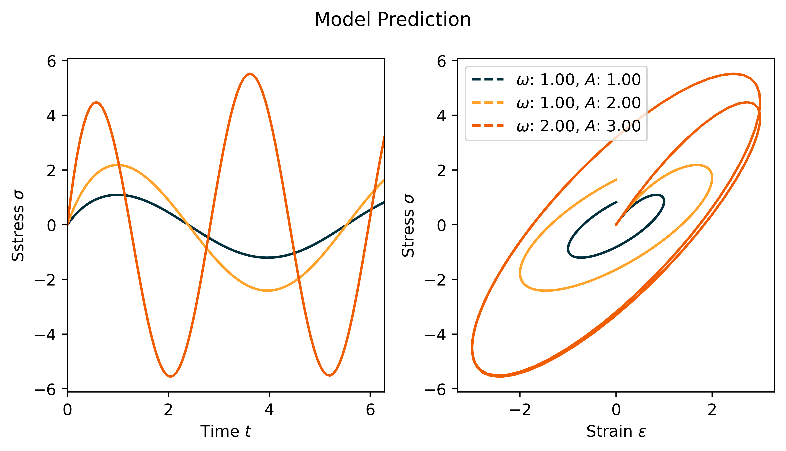
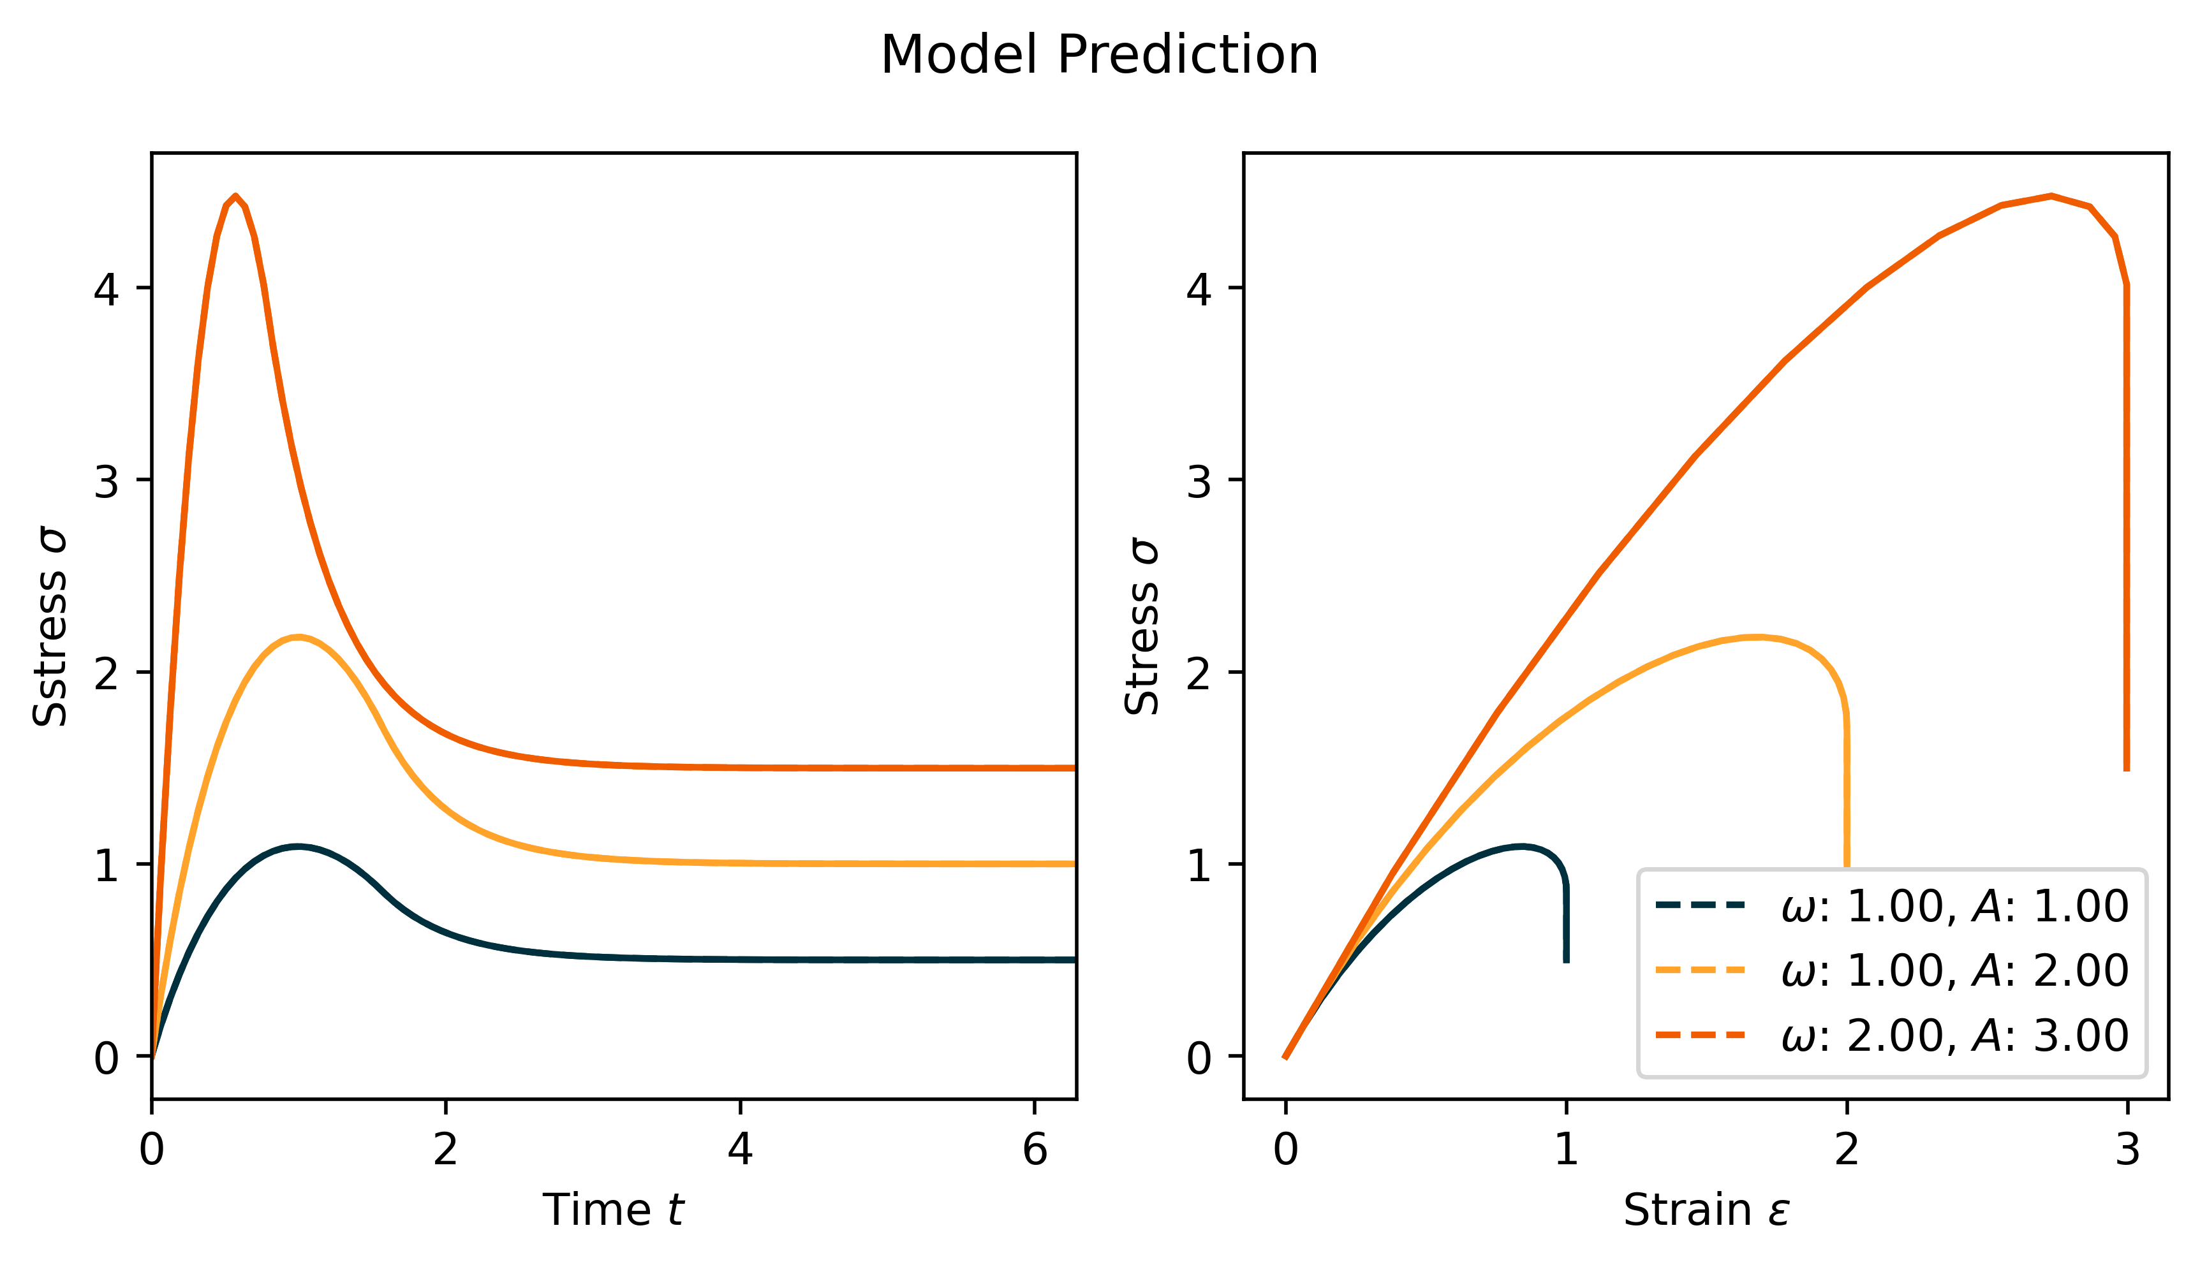
4 - 2.2
Analytic Maxwell model

Slide 26
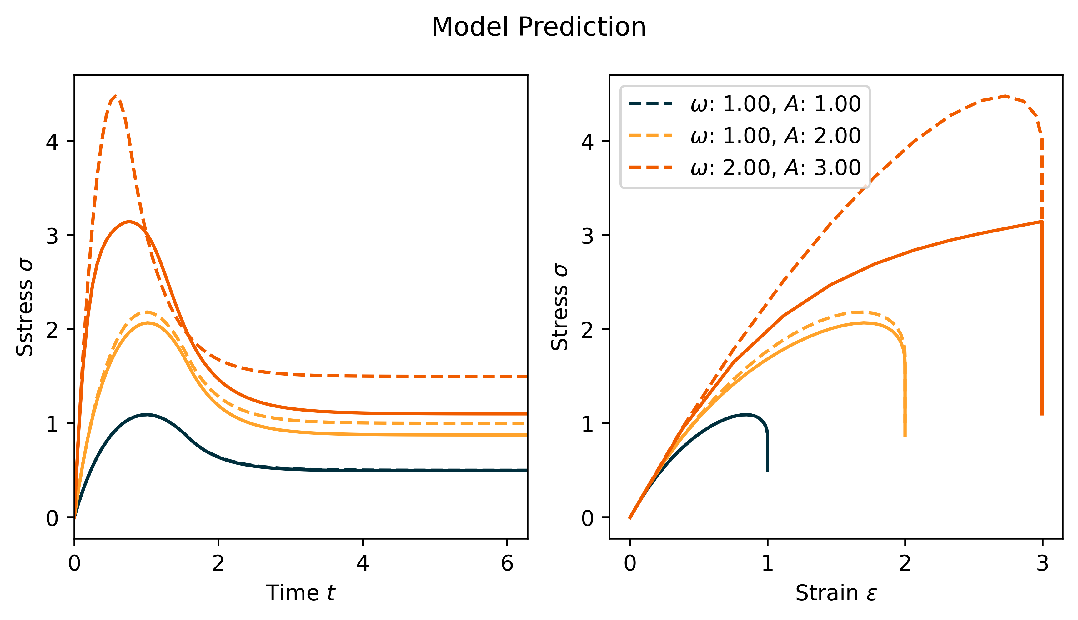
4 - 2.4
GSM model
Epochs: $10,000$
L. Rate: $0.001$
Layers: $8, 8, 1$
Trained on $ω=1, A=1$

Slide 27
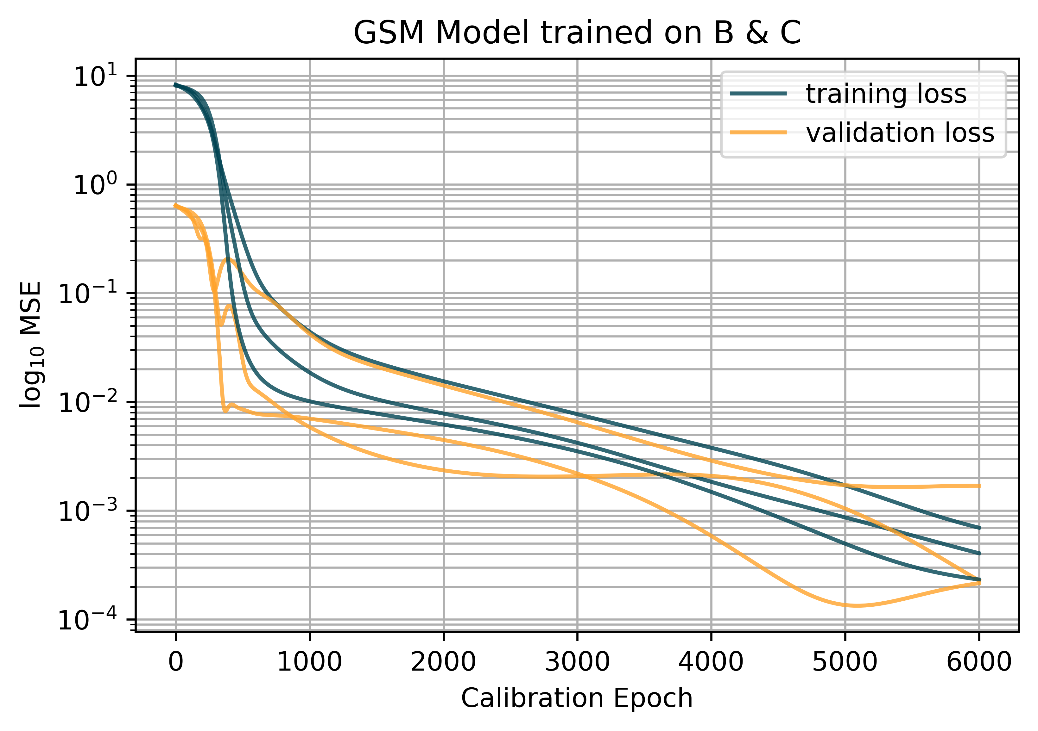
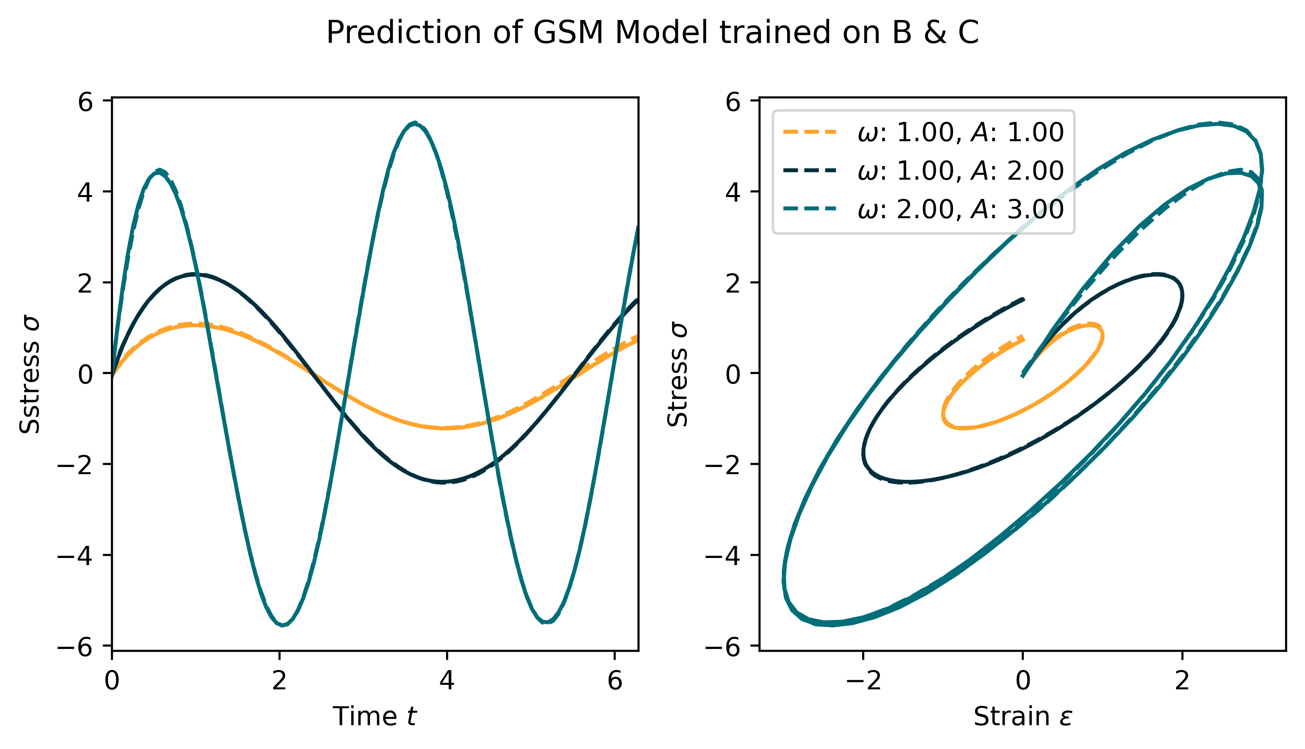
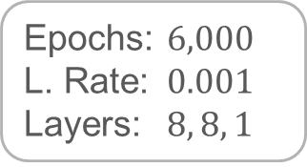

4 - 2.4
GSM model
Epochs: $6,000$
L. Rate: $0.001$
Layers: $8, 8, 1$
Trained on $B \& C$

Slide 28



4 - 2.4
GSM model
Epochs: $6,000$
L. Rate: $0.001$
Layers: $8, 8, 1$
Trained on $C$

